Slide 1
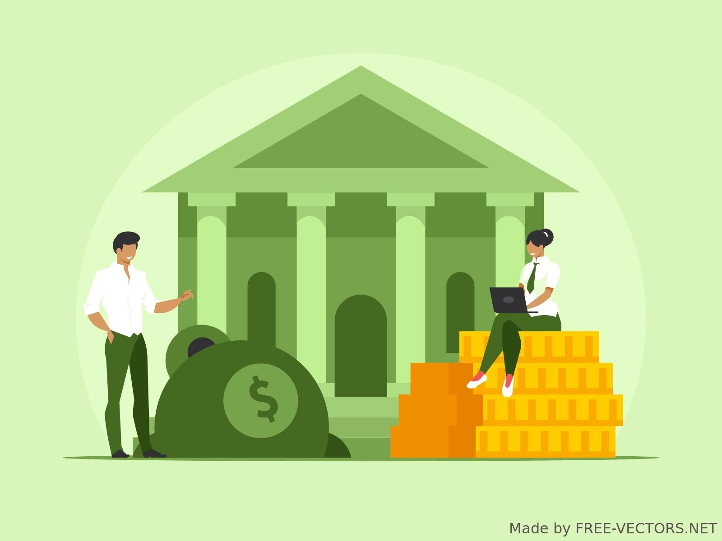
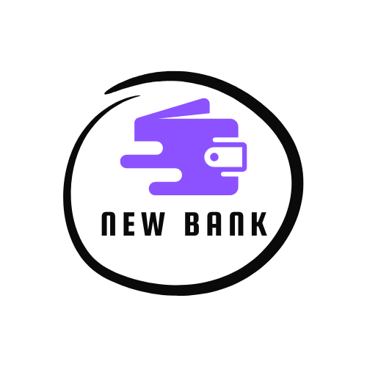
New-Bank User Engagement and Fraud Analysis
From retention to fraud prevention — decoding fintech behavior through data
Mentored by: Zein Moualla
Notes:
Hi everyone, I am priya and we’re Team NewBank, and this is our project: Neo-Bank User Engagement and Fraud Analysis. From retention to fraud prevention, we’ve explored how user behavior shapes business outcomes in fintech. Huge thanks to our mentor Zein for guiding us.

Slide 2
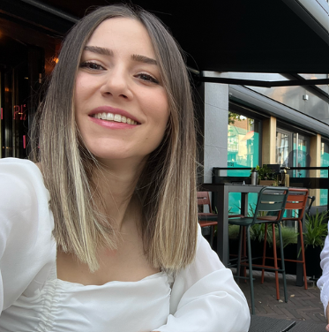
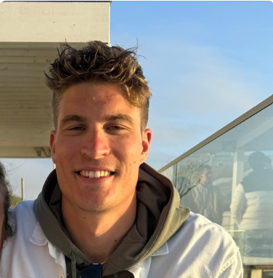
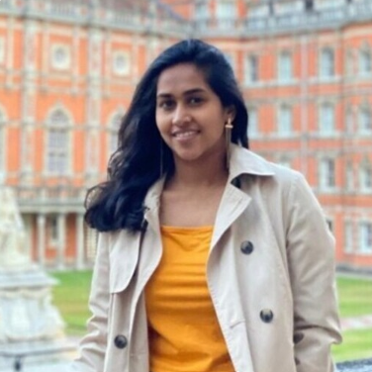
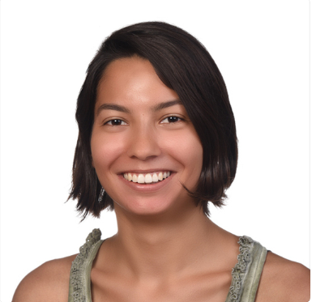
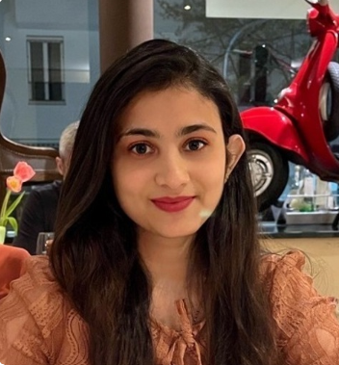
Meet the Team!
Serap
Arthur
Luxiha
Isil
Priya
Dashboard Diva
Model Magician
SQL Ninja
Future Teller
Fraud Buster
Notes:
Here’s the dream team—Serap, Arthur, Luxiha, Isil, and myself. We all brought our own superpowers: dashboards, SQL, forecasting, modeling, and fraud detection. We had a blast bringing this all together.

Slide 3
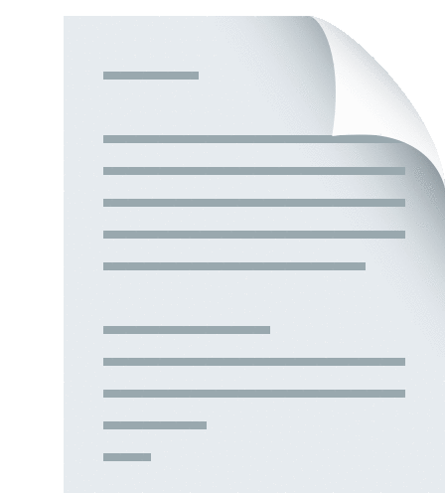
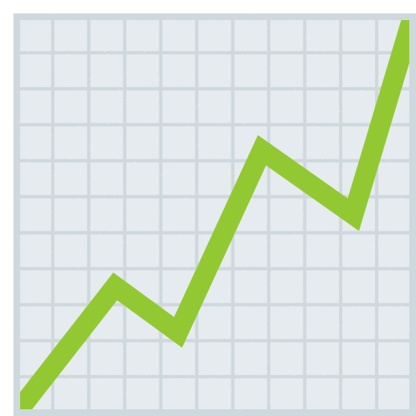


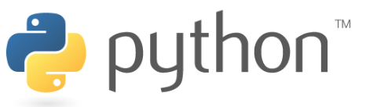


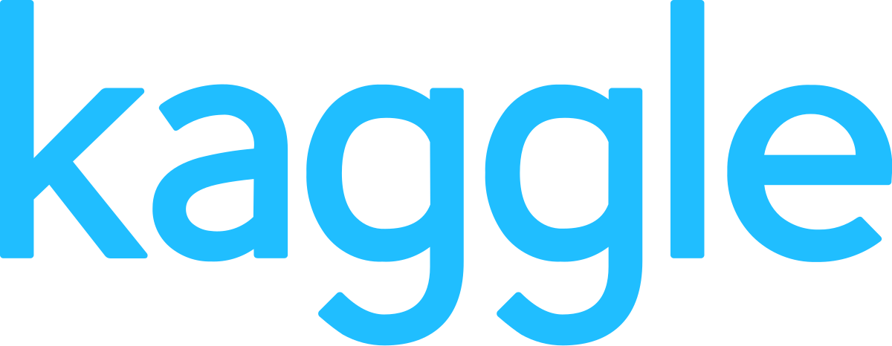




Crafting the Methodology
Guided by: Zein Moualla
Data Source:
Data Visualization:
Analytical Software and Libraries:
20XX
Data Cleaning:
Statistical Analysis:
Notes:
We started by creating an enriched user table using SQL. Then we cleaned and processed it in Python—dropping irrelevant columns and encoding features. We used libraries like Pandas, Sklearn, and Prophet to build our models and visualized in looker.

Slide 4
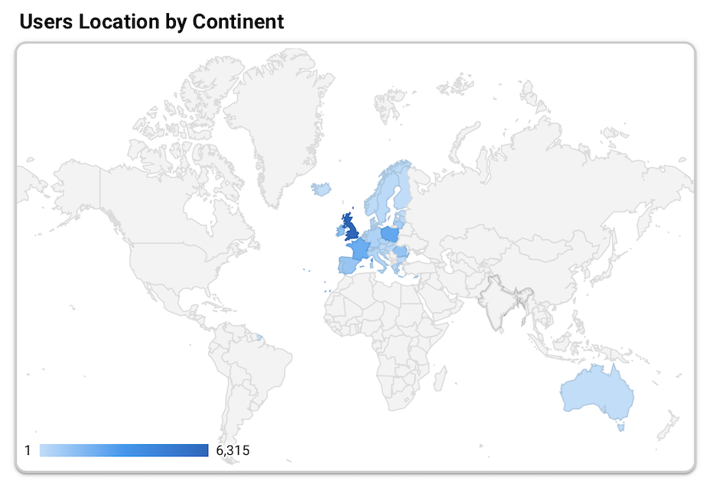
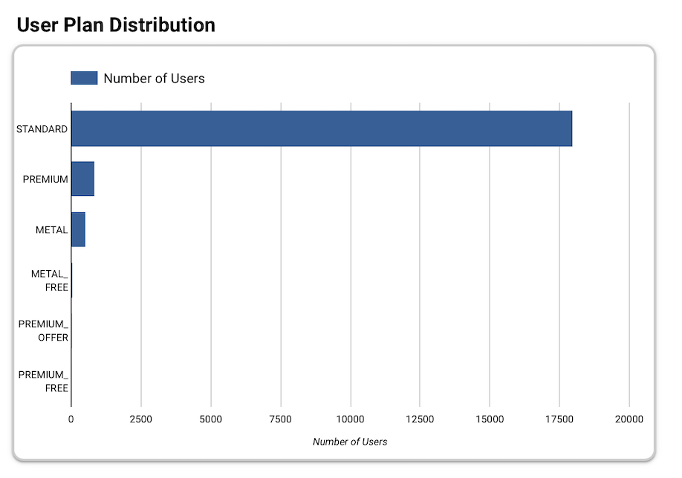
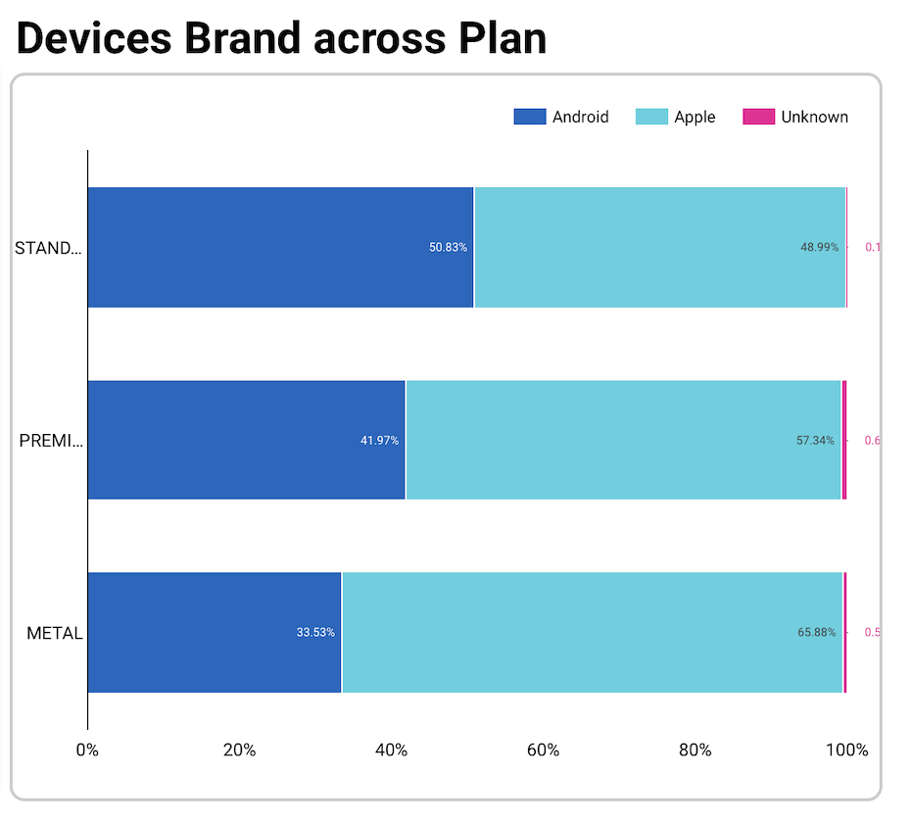
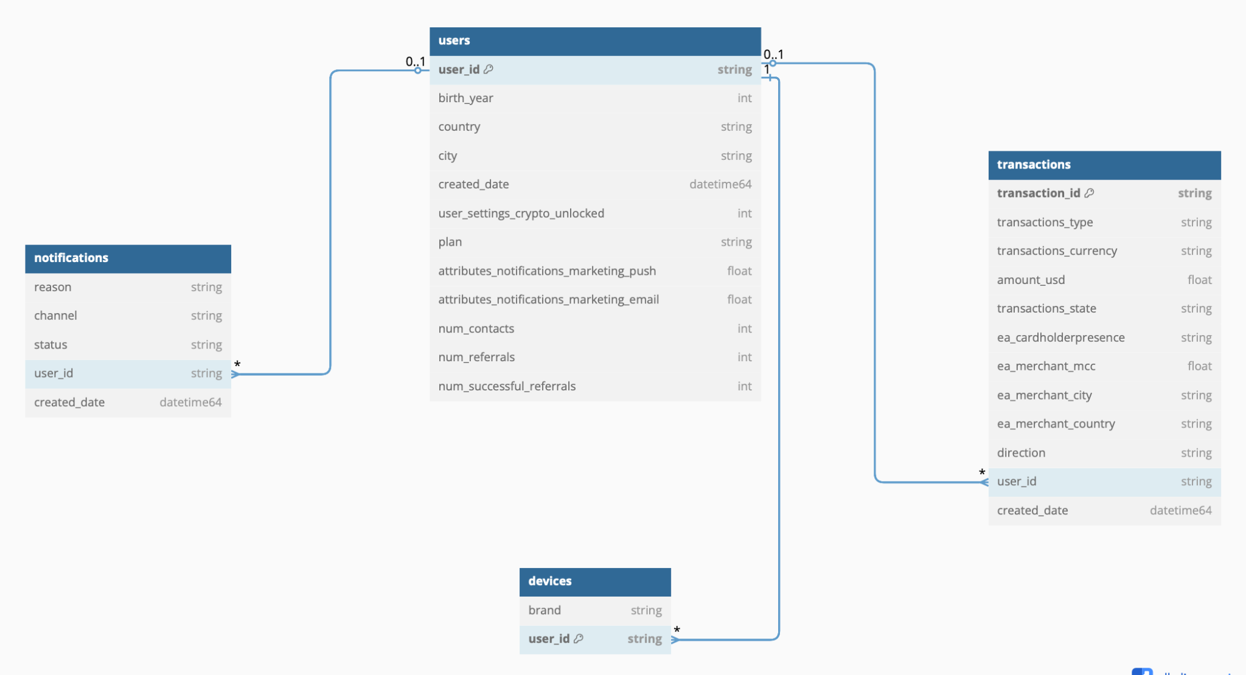
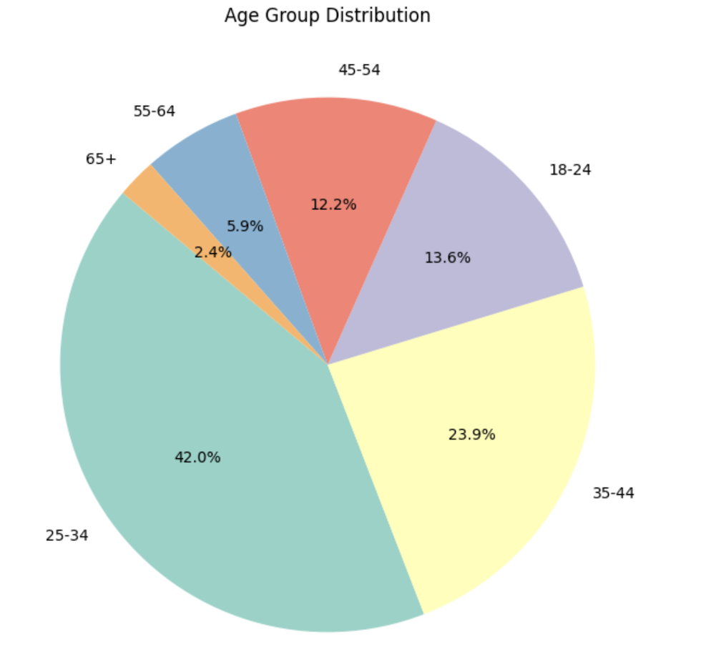
Overview of the Dataset:
Notes:
The dataset included users, transactions, devices, and notifications. This gave us a wide view of both user activity and product interactions—perfect for building engagement and fraud models.

Slide 5

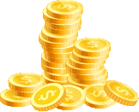

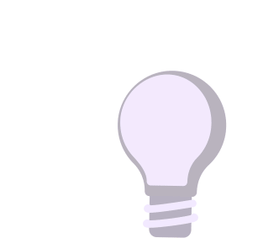
Introduction to customer churn
Definition :
Churn means customer leaving or stopping use
Costs:
reduced revenue
increased marketing
Increased acquisition costs
Causes:
poor customer service
poor competition
Solutions:
improving customer experience
increasing customer loyalty
effective retention strategies
Notes:
Churn means when a user stops using the app. It leads to lost revenue and higher marketing costs. Common causes include poor user experience and competition. So we focused on how to reduce it using data

Slide 6
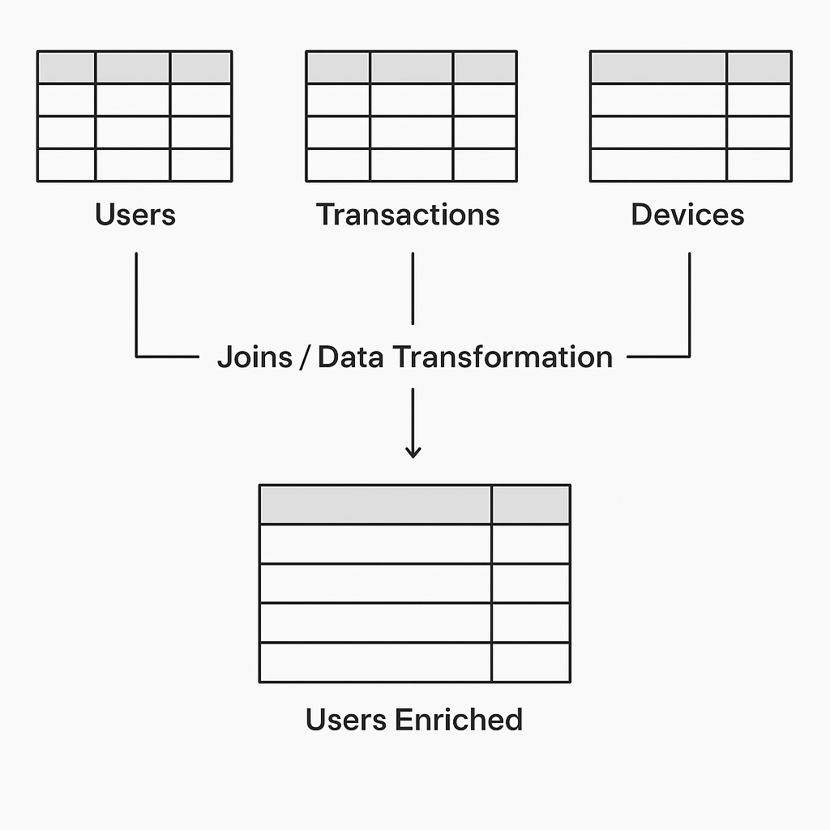
Churn prediction with ML-Model - Steps
Data transformation: using SQL we created a new “users enriched” table that contains important user information from various tables within the dataset
Data processing: using Python we removed irrelevant columns and correlated features to avoid overfitting then encoded categorical features to be able to use these features for the ML model
Random Forest model build: the dataset was splitted into test (20%) and train (80%) variable
Notes:
We engineered features in SQL, cleaned and processed them in Python, and split the data 80/20 for training and testing. We used a Random Forest model to predict users most at risk of churn

Slide 7
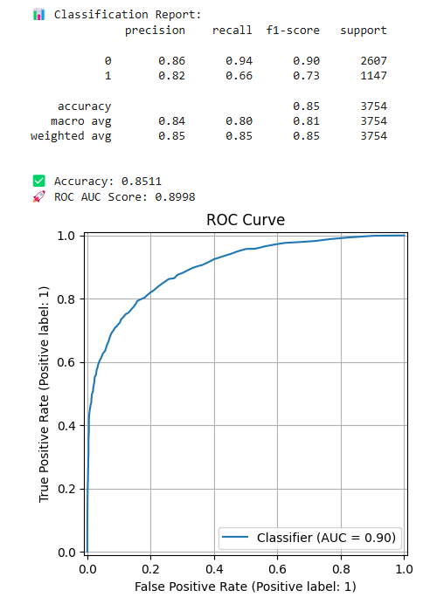
Churn prediction with ML-Model - Results
The model helps identify high-risk customers, enabling proactive retention strategies like targeted marketing
85% accuracy
82% precision
66% recall
73% F1 score
Notes:
Our churn model achieved 85% accuracy, 82% precision, and a 73% F1 score. That means the business can now proactively target at-risk users and reduce churn through re-engagement.

Slide 8
EDA insights about Churn Analysis:
Churn Rate: There’s a 38% churn rate with middle aged adults (55- 64) accounting for the majority of the Bank’s churn.
Customer Churn Geography Analysis: Great Britain has a 37% churn rate which is the highest compared to France (32%) and Poland (28%)
Churn Bank Plan Analysis: Standard Plan has a 33% churn rate
Notes:
“We found the churn rate is highest among middle-aged users, especially in Great Britain. Also, users on the Standard plan are more likely to leave—hinting that plan’s value might need reevaluation.”

Slide 9
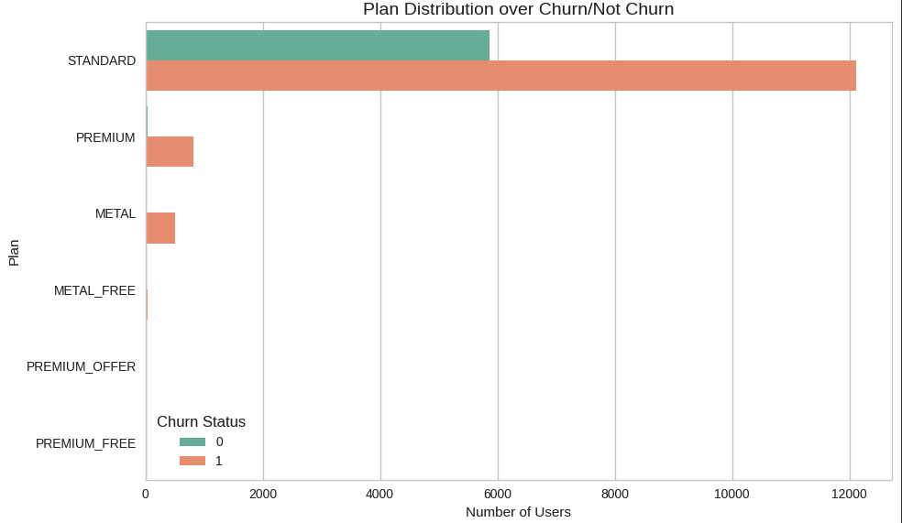
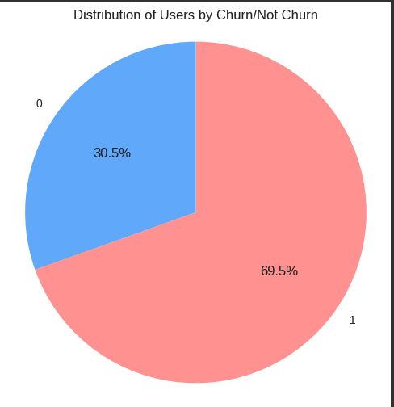
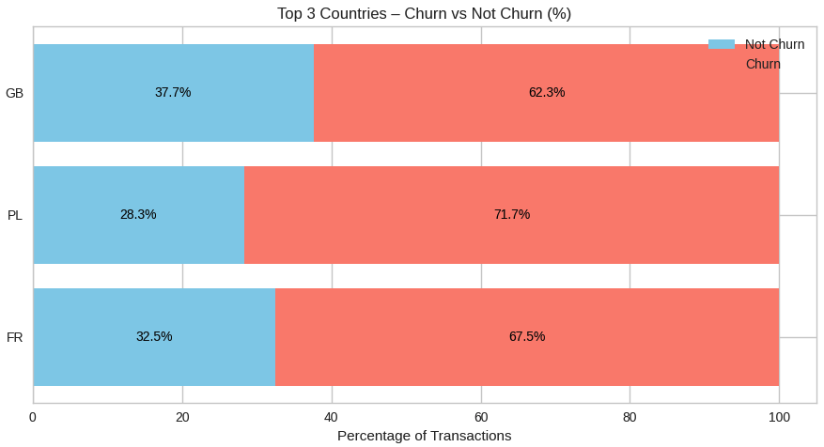
Churn Analysis Visual Insights:

Slide 10
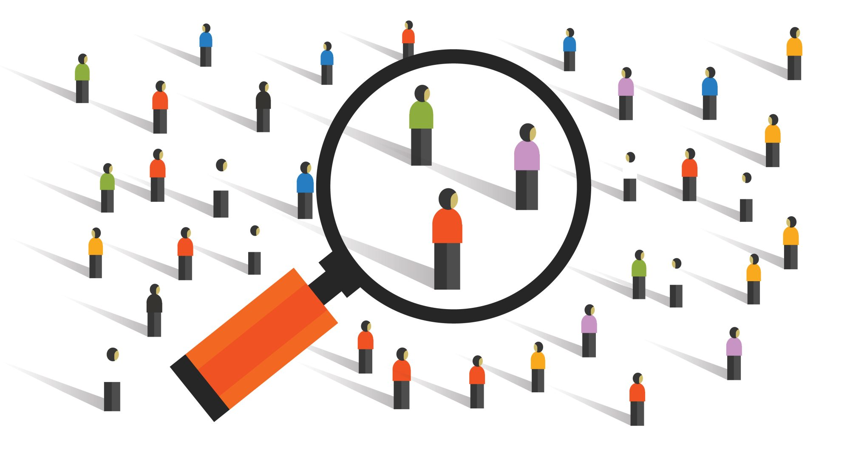
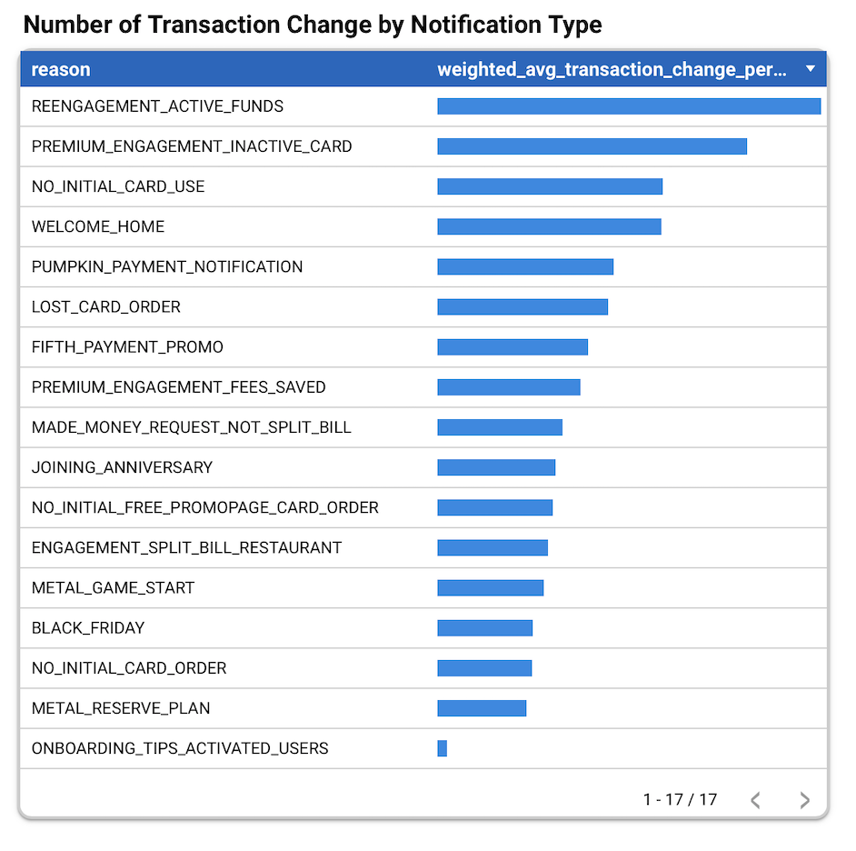
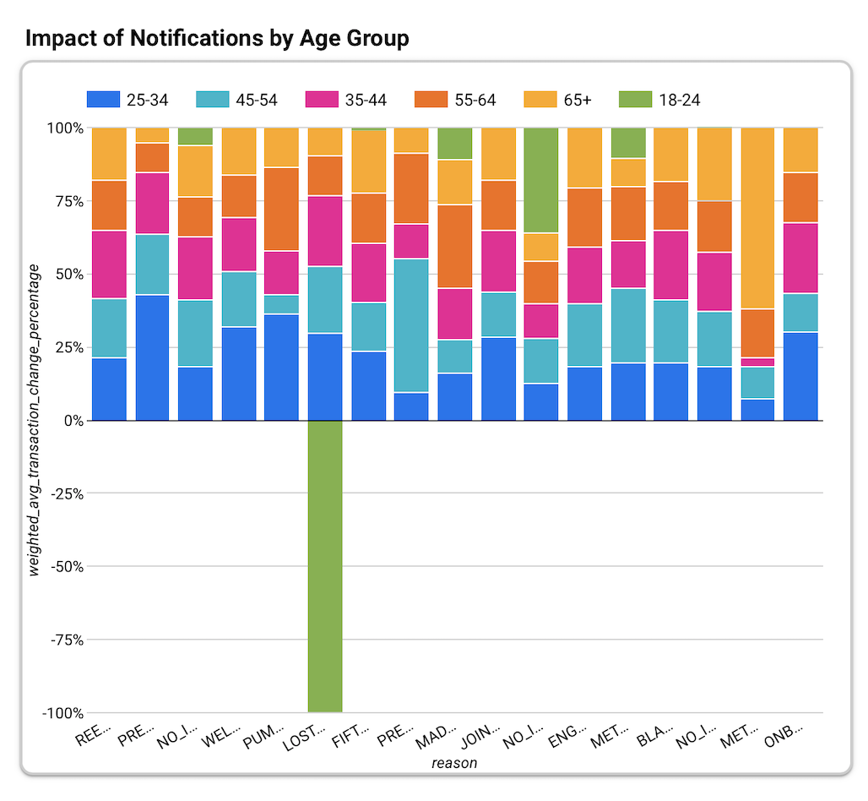
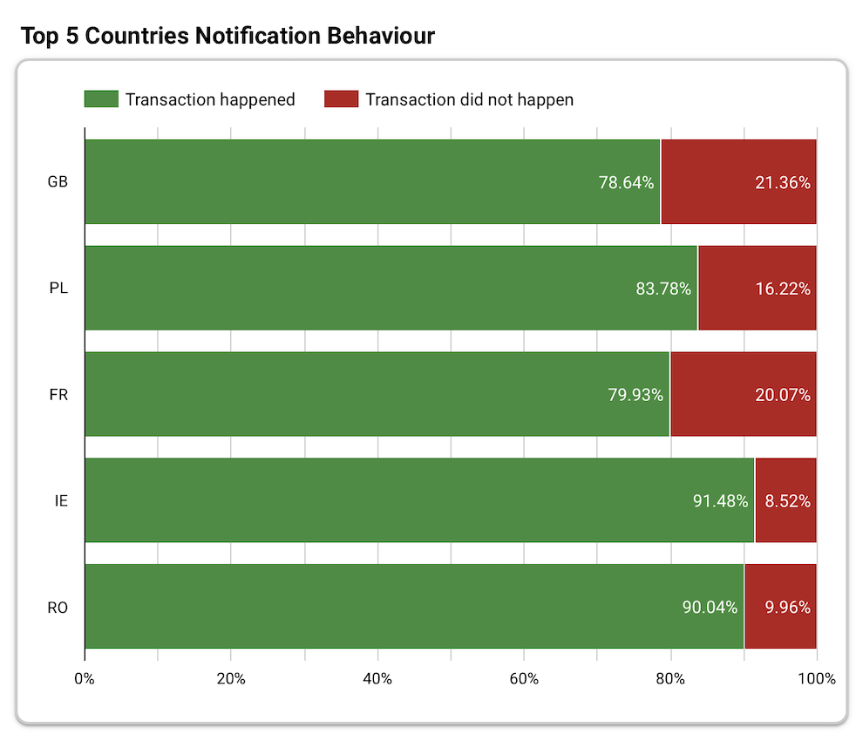
Notification Effectiveness & Demographics
Notes:
We found users who accepted marketing notifications were significantly more engaged—especially email opt-ins. We also discovered high contact activity in users with crypto features and free trial plans.

Slide 11
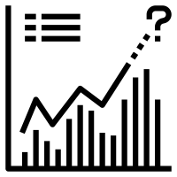
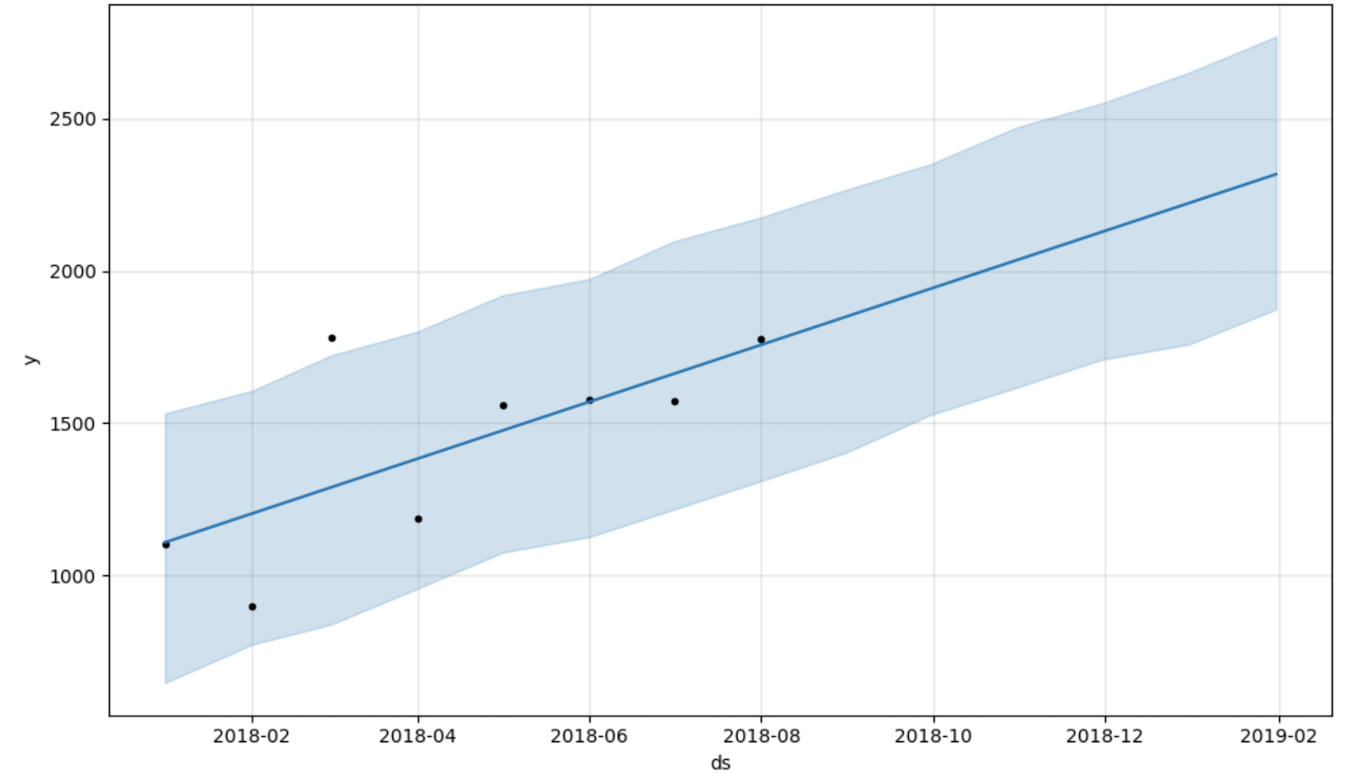
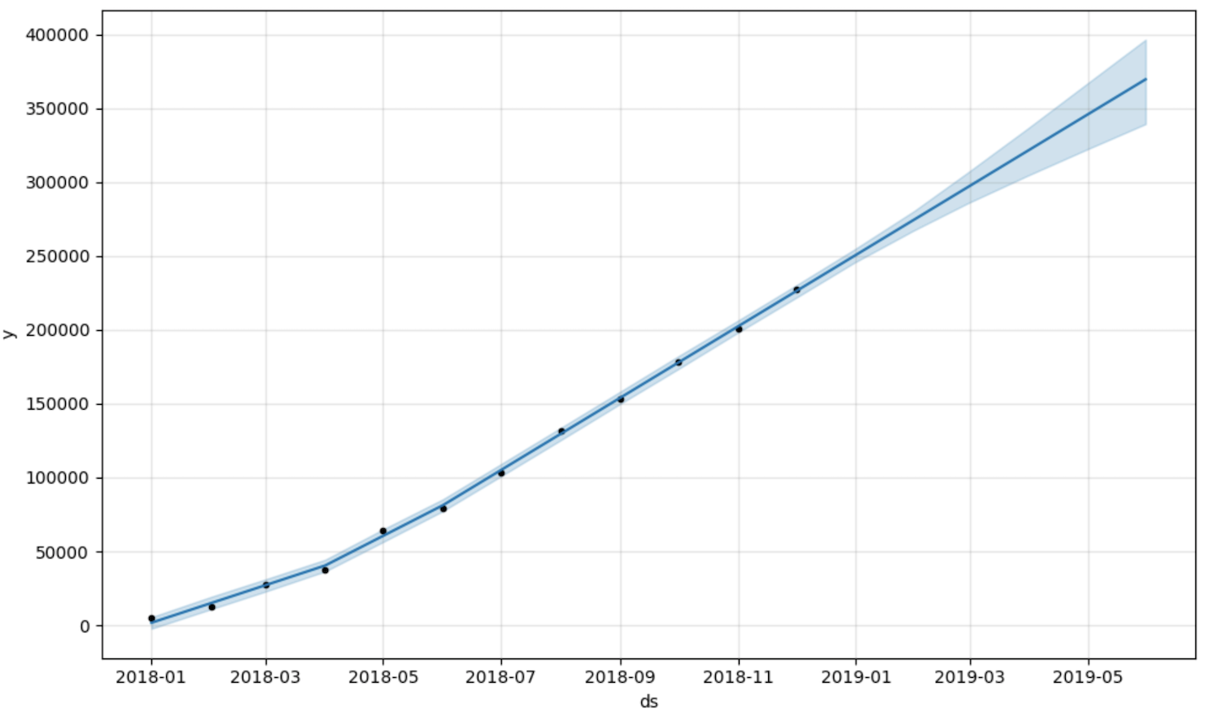
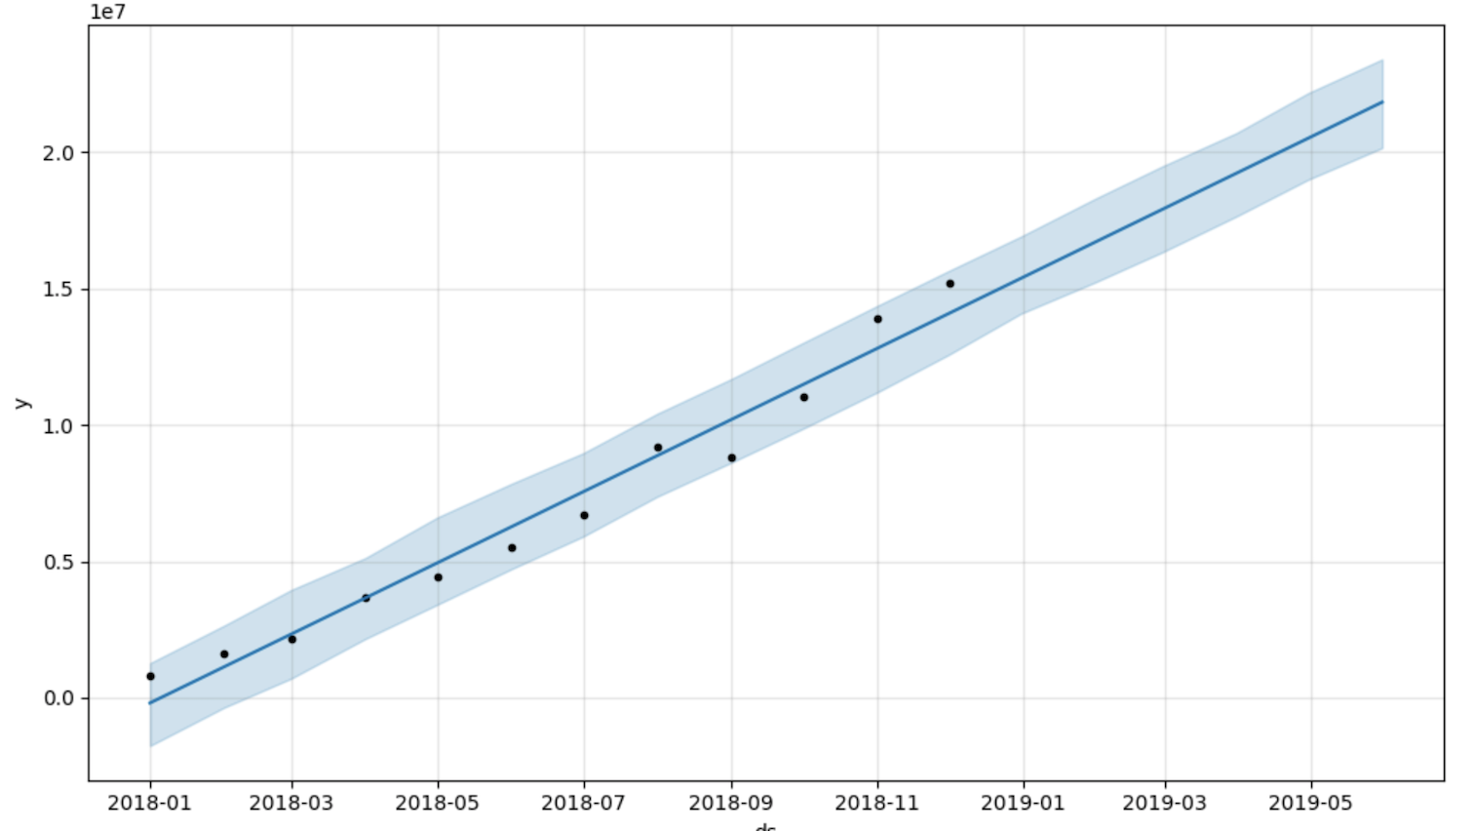
Predicting Trends with Facebook Prophet
Users prediction for next 6 months
Transaction Count prediction for next 6 months
Transaction Amount in USD $ prediction for next 6 months
Notes:
We used Facebook Prophet to forecast the next six months of user growth, transaction amounts, and transaction counts. These projections help plan marketing efforts and infrastructure scaling.

Slide 12
While engagement keeps users in, fraud pushes them out. So we built a system to spot suspicious activity before it causes any damage

Slide 13
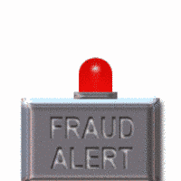
Fraud Detection:
From hugs to heists—here’s how we catch fraudsters before they catch us!
Notes:
From hugs to heists—let’s talk fraud. Alongside engagement, we built a system to detect suspicious activity using a hybrid approach

Slide 14
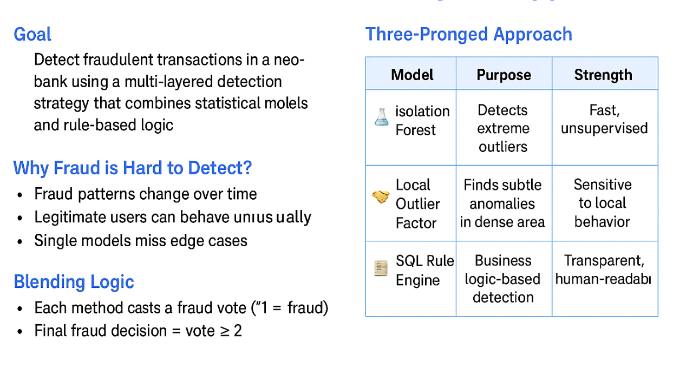
Fraud Detection Overview: Hybrid Approach
Notes:
We combined Isolation Forest, Local Outlier Factor, and SQL rules. Each method catches different types of fraud.

Slide 15
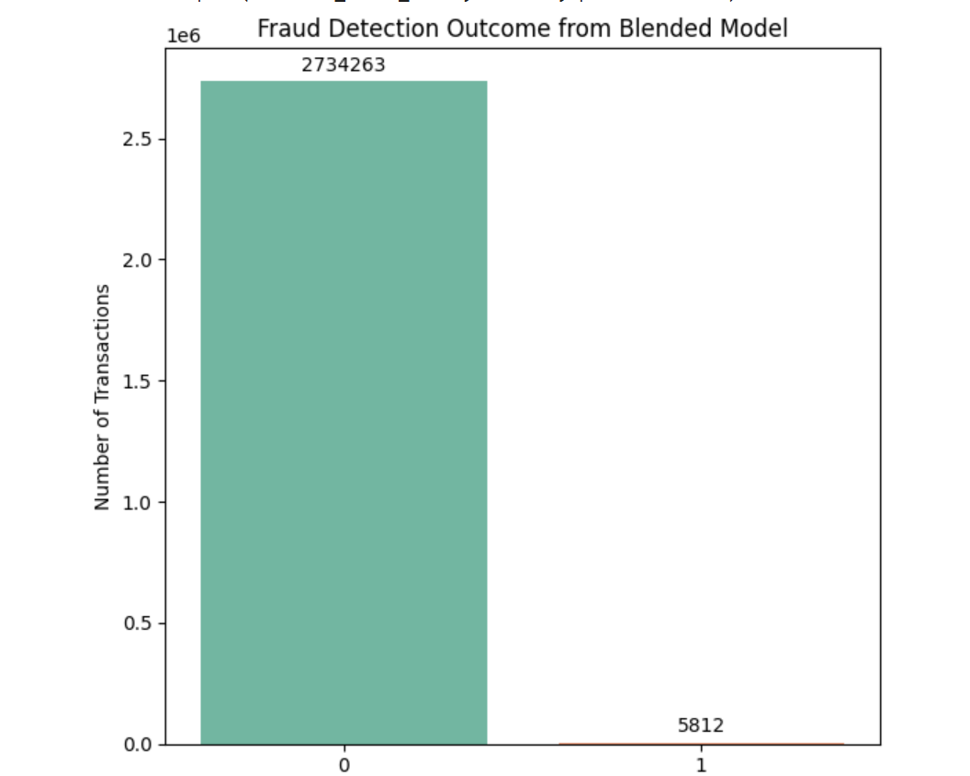
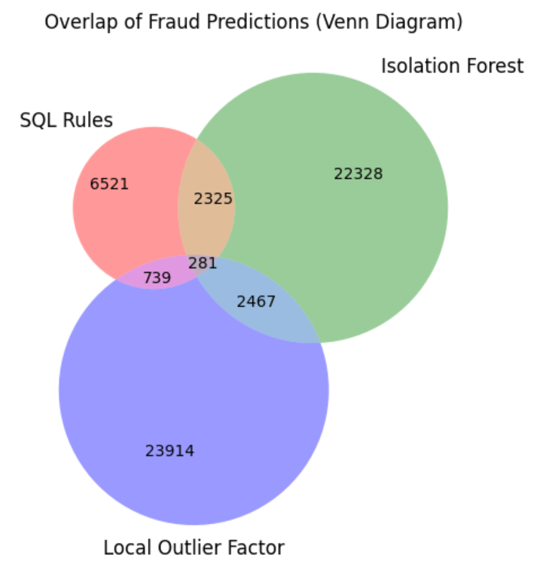
Hybrid Fraud Detection Strategy
0.22% of transactions are agreed to be suspicious or fraudulent by the hybrid model
Blended Fraud Detection Strategy:
Notes:
0.22% of transactions are agreed to be suspicious or fraudulent by the hybrid model

Slide 16
Key Insights
1
📬100% notification delivery
Device Use: Android = 53.1%, Apple = 46.6%, Unknown = 0.3%
2
🪙 Free trial users (METAL_FREE, PREMIUM_OFFER) show high engagement
💎 Premium Plan Adoption: Highest in Unknown users (25.7%), then Apple (12.4%)
3
🔁 STANDARD users over-targeted with fund re-engagement — diversify
₿ Crypto Unlocked: 43.1% of Unknown users vs 21.8% Android, 19.7% Apple
4
₿ Crypto unlock = +15% engagement boost
5
📧 Email opt-in users = most engaged → prioritize email campaigns
Notes:
Key takeaways: STANDARD users get too many fund-based notifications, while METAL_FREE and PREMIUM_OFFER users are highly engaged. Crypto unlocks boost engagement by 15%, and email opt-ins are the most active users.

Slide 17
Recommendations:
Launch Targeted Retention Campaigns for Middle-Aged Users (55–64)
Prioritize User Retention Initiatives in Great Britain
Reevaluate Value Proposition of the Standard Plan
Automate Action on High-Confidence Fraud Cases
Collaborate with the CRM Team for Fraud Case Validation
Notes:
Here’s what we suggest: Launch targeted campaigns for middle-aged users, prioritize retention in Great Britain, improve the Standard plan’s value, and automate fraud alerts. Also, work with the CRM team to validate high-confidence fraud cases

Slide 18

THANK YOU!
We appreciate your time
Made with ❤️ by Team NewBank
Special thanks to our mentor Zein Moualla and the amazing team at Le Wagon Bootcamp for guiding us through this journey
Notes:
Thank you so much for your time. We’re proud of what we’ve built, and grateful to our mentor Zein Moualla and Le Wagon Bootcamp for their incredible support. We’re happy to answer any questions

Slide 19

Notes:
We’d love to hear your feedback or any questions. Let’s talk retention, fraud, or forecasts!

